Slide 1

New Parents and Carers Welcome Meeting
Tuesday 17th March 2026

Slide 2
September 2026
Meet the staff:
Headteacher : Mr I. Curnow
Deputy Headteacher: Mr D. Adams
Assistant Headteacher and SENCo: Mrs K. Fellows
Phase Leader (TREES – Years 7 and 8): Mr A. Sant
Designated Safeguarding Leader and Safe and Well Being Hub Leader: Mrs D.Doman
Family Liaison Officer: Miss A. McPherson
Reflection (Behaviour/ Nurture) Lead: Mrs M. Baker
HLTA (Speech and Language Lead) – Mrs D. Hudson
HLTA (Physical and Sensory Lead) - Mrs S. Heeley Smith
Learning Facilitator/ SENCo support – Mrs L. Gibbons

Slide 3
Your Teachers:
7T1 Teacher: Miss M. Gill
7T2 Teacher: Mrs R. Hand
7T3 Teacher: Mrs L. Curnow
7T4 Teacher: Mrs J. Plant

Slide 4


Slide 5
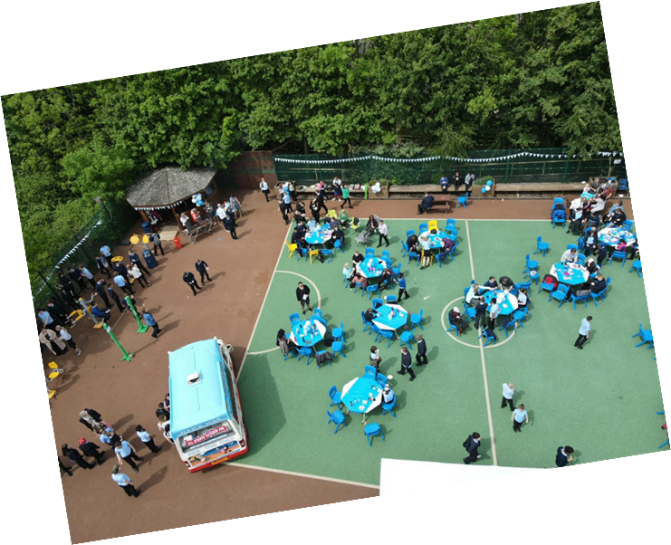
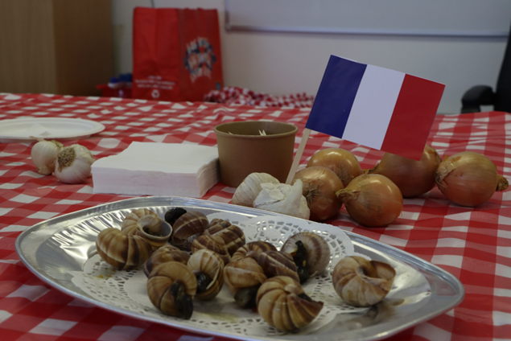
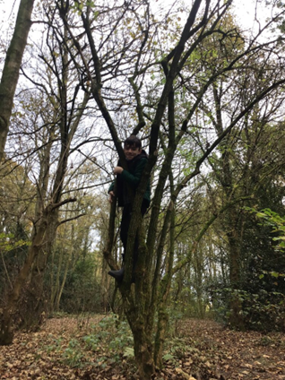
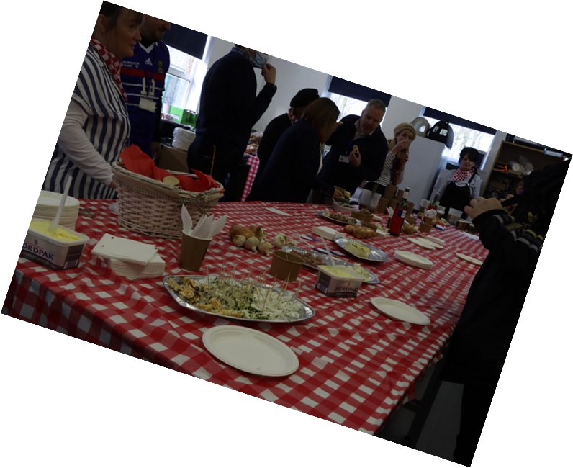
Enriching Experiences:

Slide 6
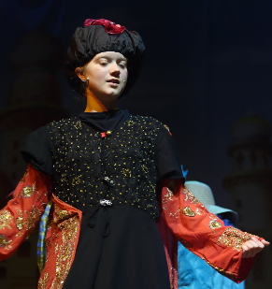
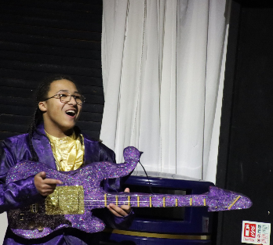
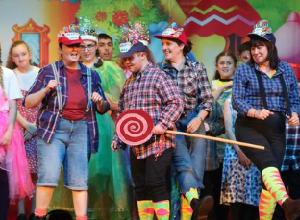
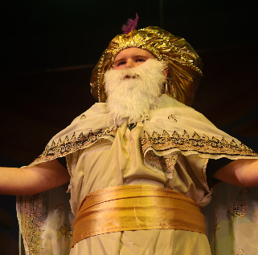
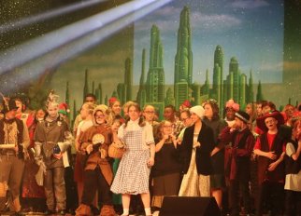
School Shows:

Slide 7
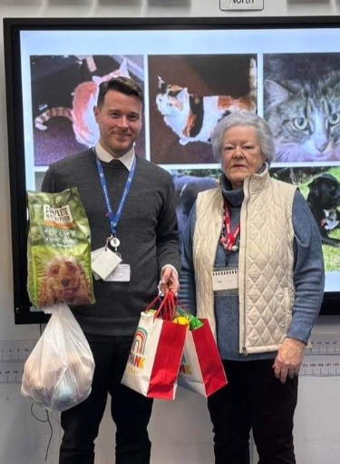
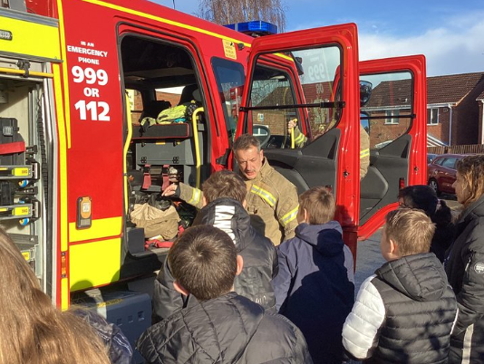
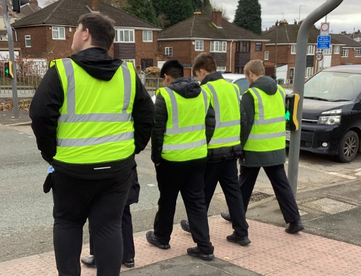
Beyond Sutton:
Charity Fundraising
Road Safety
Fireman Nik

Slide 8
Outside Professionals:
We work collaboratively with a range of different professionals to ensure the needs identified on your child’s EHCP are met.
These include:
Occupational Therapy / Physiotherapy
Learning Support Services
Educational Psychology
School Nurse
School Counselling/ Reflexions/ ELSA
Hearing Impairment/ Visual Impairment Services
CIPS (Communication, Interaction, Physical and Sensory)
NHS Speech and Language Therapy Services

Slide 9
Additional Specialist Services
Occupational Therapy Services
Speech and Language
Hydrotherapy
Physio

Slide 10
Transition for your child:
Let’s Make Friends: Monthly
Welcome Meeting: Today
Transition Week:
W.C 29th June – 3rd July
4. Connecting with current school:
Attending annual reviews
TEAMS Professionals meetings
Visiting Primary settings
5. Additional visits to Sutton

Slide 11


Transport

Slide 12
School Uniform: Please check website
Uniform
Light blue polo shirt
Navy-blue crew or V-neck jumper
Black trousers, tailored shorts in black/dark grey or skirt
Black shalwar or kameez
Black shoes
PE Kit: All items of clothing should be clearly labelled.
Navy Blue Jumper
White Polo T-shirt
Black shorts or black tracksuit bottoms
Trainers
Change of socks (Grip socks can be worn in gymnastic activities)
Towel
* Please note that hoodies are not permitted within school and cannot be worn during PE lessons.

Slide 13
Primary Transition Week:
Date | Key Focus | Class
Monday 29th June | 9:00 a.m. – 12:00 p.m. Transition into new setting: Arrive at trees entrance and exit (not the main reception). Pupils meet and greet their new class teacher, LF’s and their new peer group within their new classroom. Introduction to key staff members throughout the morning. Tour of the school, outside area. Pupils stay for lunch – bring their own packed lunch. Parents collect at 12:00 p.m. From the Trees entrance and exit. | 7T1
Tuesday 30th June |  | 7T2
Wednesday 1st July |  | 7T3
Thursday 2nd July |  | 7T4
Friday 3rd July | 9:00 – 12:30 p.m. Same arrival/exit and lunch details. Planetarium day. | Whole of the new Year 7.

Slide 14


Safe and Wellbeing hub
Mobile phones in School.
Social Media and Online Safety.
Support Services.
Parent Partnership.

Slide 15



We can’t wait to see you in September!

