Slide 1


Our contact details:
PC Paul Davies- Young Persons Officer
paul.davies@west-midlands.pnn.police.uk
Twitter: pcpaul999
Heather Jeavons- Dudley Grid for Learning
hjeavons@dgfl.org
Juliet Joy- Dudley Grid for Learning
jjoy@rm.com
Kat Lafferty- DMBC Community Safety Team
Katriona.Lafferty@dudley.gov.uk

Slide 2
Online safety awareness for parents and carers
Presenter:
( insert own graphics)
Suggested introduction videos- NCA CEOP Offender Animation
Where’s Klaus?
Do you know where your children are tonight?

Slide 3
Digital Parents
Safety is about behaviour
Keeping children safe is about parenting!
Parenting Online
Really no different to what we already do
Set and adjust boundaries-age/maturity related
Get to know what applications your children and their friends use
Model good behaviour- you are a role model
Provide guidance and ensure they are shared with family members
Keep talking to them
How to protect your children?
You could remove the hazards and minimise the risk. How?
At what cost?
These only work until someone works out how to bypass them!
If you rely on a technological solution to stay safe how will your child cope when the technology fails or they are using their devices elsewhere?

Slide 4
Digital Resilience
Employ the same parenting skills you use offline to keep them safe, such as negotiating boundaries, talking about the difficult subjects we’d all rather avoid, helping your child to recognise what’s good and bad behaviour.
Set fair and consistent rules in relation to your child’s internet use at home. As they get older, try to agree the rules with them so that they have some control over their digital world.
Teach your child to think critically about what they read, see or hear online. Helping your child to understand that and to pause and think about the impact of things that are posted online, will help them cope with some of the difficult behaviour they will come across and avoid getting caught up in it.
Maintain a positive outlook on your child’s use of the internet, if you constantly criticise the apps and games they love, they’re not going to want to talk to you about their online life.
Children who can recover from an online mistake can learn and avoid making the same mistake again. You can help by making it easy for them to talk to you about their mishaps (that means trying to keep calm even if you’re at your wits’ end!), making sure they know where to go for help if they need it, and recognising if they’re not recovering well, so you can step in and get help for them.
Allow your child to explore and take charge of their online life.

Slide 5
Technical solutions ( information that can be signposted via your web site)
There are four main places you can find parental controls, and it can help to set up a combination of these:
Internet provider: you can set up filters to help block access to inappropriate content on any device that connects to your home Wi-Fi
Mobile operator: filters are often automatically set up on mobile contracts, but you can double-check with your provider
Devices: many devices have parental control settings, for example, to help restrict spending in apps or disable location functions
Online services: sites like BBC iPlayer, Sky, Virgin Media and YouTube have parental control settings or passwords to help restrict access to inappropriate content

Slide 6
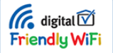
Technical solutions ( information that can be signposted via your web site)
Children are accessing the internet on a range of different devices.
You can now access the internet wherever and whenever you want.
Devices connect to the internet in three main ways, and you might want to consider filtering options:
3G/4G: this provides access to the internet when you're on the go, and is often provided as part of your mobile phone contract. Filters are often set up by default, but you can check with your mobile operator to ensure they are activated for your children's devices.
Connect to your home Wi-Fi: devices can connect to the internet at home (and this saves using up your 3G/4G data allowance). All of the major internet providers offer free filtering tools that work across all devices connected to the home internet.
The UK Safer Internet Centre provides guides from BT, Sky, Talk Talk and Virgin Media.
Access public Wi-Fi: it's also possible to connect to public Wi-Fi when you're out and about, with shops, cafes and restaurants increasingly offering internet access.
The Friendly Wi-Fi symbol means the content has been filtered.

Slide 7

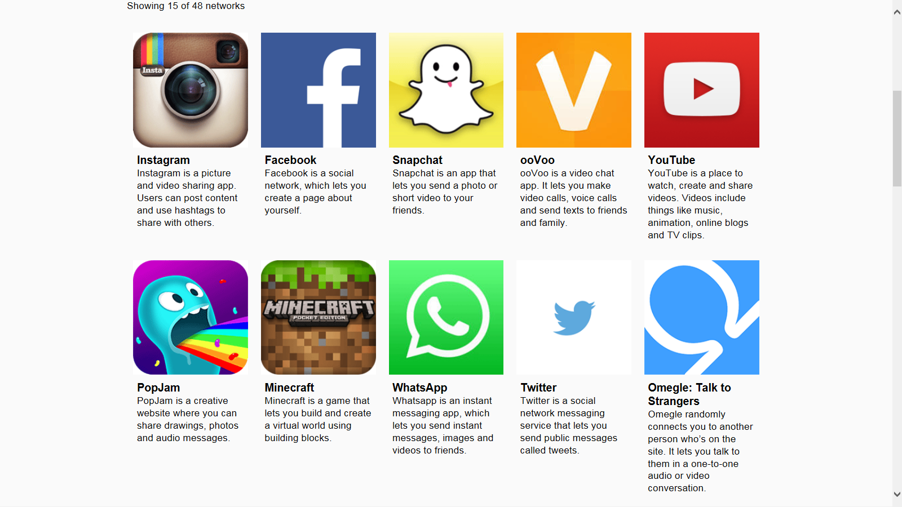














What sites do you use? ( personalise to reflect trends)

Slide 8
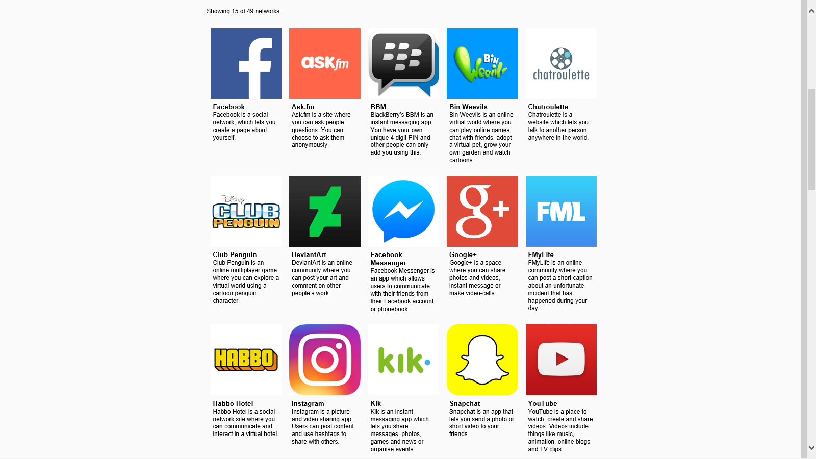
Trends amongst youngsters: Net-Aware
What sites do your children use?
http://www.net-aware.org.uk/networks/?order=-popularity#
Notes:
The ‘trending’ sites change.
There will be ‘trends’ within each class/year group.

Slide 9


Anonymous chat apps
4Chan-Anonymous image board where users can discuss and post pictures in a specific thread
Whisper is an anonymous social networking app. Users post confessions, either fact or fiction, by super imposing text on a picture.
Ask fm-Users follow each other anonymously. But kids also can be very visible, such as filming and posting video responses to user questions and sharing personal photos on the site.
Notes:
Change/delete to reflect trends.

Slide 10


Anonymous chat apps
YikYak is an anonymous social media app for iOS and Android. It allows people, pseudo-anonymously, to create and view discussion threads within a 5-mile radius (termed "Yaks" by the application).
Kik is a free messaging app for smartphones. You log in, you pick a user name, and you send texts, selfies, and emojis to your friends. Crucially, you can find and chat with total strangers on Kik. Two of the top five internal apps are ‘Flirt!’, which gives you a list of users in your age range to, flirt with, and Match & Chat, a Tinder-for-Kik that lets you swipe left or right on users and chat with the people who swipe right on you too.

Slide 11



Report Abuse/Concerns
Are you worried about online sexual abuse or the way someone has been communicating with you online? https://www.ceop.police.uk/safety-centre/
If you are being bullied you can talk to Childline. https://www.childline.org.uk/
Don’t forget you can speak to someone at school.

Slide 12
Common Issues
( focus as appropriate/add/delete/amend)
Sexting/revenge porn
Emotional health and well being
Sextortion
Cyberbullying
Grooming
Self-trolling
Trolling
Notes:
Common issues, as of January 2018- that are a focus for Online safety as part of Safeguarding.
Online activity may also dove-tail into other Safeguarding issues that are identified in ‘Keeping Children Safe in Education.’

Slide 13
Cyberbullying
‘Cyberbullying is bullying that takes place over digital devices like mobile phones, computers, and tablets. Cyberbullying can occur through SMS, text and apps, or online in social media, forums, or gaming where people can view, participate in, or share content. Cyberbullying includes sending, posting, or sharing negative, harmful, false, or mean content about someone else. It can include sharing personal or private information about someone else causing embarrassment or humiliation. Some cyberbullying crosses the line into unlawful or criminal behaviour.’
The most common places where cyberbullying occurs are:
Social Media sites such as Facebook, Instagram, Snapchat and Twitter
SMS (Short Message Service) also known as text messages sent through devices
Instant Message (via devices, email provider services, apps and social media messaging features)
Email
Remember cyberbullying happens ‘in and out of the school gates’. It doesn’t stop at the end of the school day, it can happen 24 / 7 in a child or young person’s own bedroom and can have an audience of millions.

Slide 14
Legal Implications
Guidelines on prosecuting cases involving communications sent via social media
The Crown prosecution service has released guidelines (Dec 2013) around cases involving communications sent via social media. These guidelines explain how these communications will be considered under current law and include four reasons why somebody may get into trouble for behaviour using new technologies (e.g. social networking, blogs, emails, mobile phones etc):
Credible threats
If a threat is made towards a person or to damage property and it is believed that threat may be carried out
Communications targeting specific individuals
This can include communications (text, pictures, videos etc) sent by more than one person (e.g. cyberbullying / trolling by lots of people aimed at one person) or sent to more than one person (e.g. cyberbullying / trolling a group of people)

Slide 15
Legal Implications
Guidelines on prosecuting cases involving communications sent via social media
Breach of court orders
If a judge has made an order that certain information or pictures should not be shared online and then it is shared
Communications which are grossly offensive, indecent, obscene or false
Most of these communications will fall into one of the first three, this one is for really bad communications – NB the offence is actually sending the communication – nobody needs to have seen it once sent

Slide 16
Sexting
Sexting is when someone shares sexual, naked or semi-naked images or videos of themselves or others, or sends sexually explicit messages.
They can be sent using mobiles, tablets, smartphones, laptops - any device that allows you to share media and messages-rf NSPCC.
Is sexting against the law?
Having sexting photos, text messages or videos on your phone or computer:
If you are under the age of 18, the law sees you as a child. Therefore, if you have any indecent images or videos of somebody who is under 18 you would technically be in possession of an indecent image of a child – even if you are the same age. This is an offence under the Protection of Children Act 1978 and the Criminal Justice Act 1988.
Sending sexting photos or videos
If you are under 18 and you send, upload or forward indecent images or videos onto friends or boyfriends/girlfriends, this would also be breaking the law, even if they are photos of yourself ('selfies').
http://www.telegraph.co.uk/news/uknews/crime/11840985/Teenage-boy-added-to-police-database-for-sexting.html

Slide 17
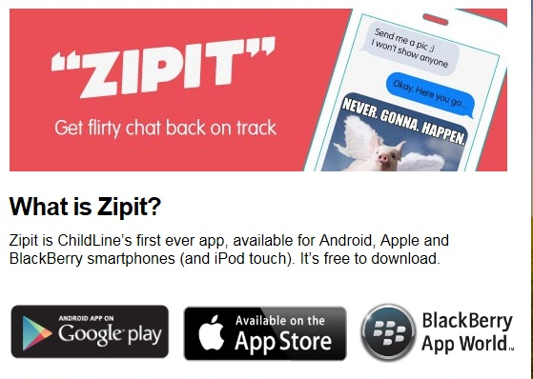
Sexting
However, as of January 2016 in England and Wales, if a young person is found creating or sharing images, the police can choose to record that a crime has been committed but that taking formal action isn't in the public interest.
Crimes recorded this way are unlikely to appear on future records or checks, unless the young person has been involved in other similar activities which may indicate that they're a risk.
( your educational establishment’s policy
and procedure for dealing with these instances
may need to be reinforced at this point)
What is posted online can stay with you for ever!
Notes:
It may be appropriate to share, without breaking any confidentiality, examples of incidents that you are aware of.

Slide 18
Sexting -NSPCC/ChildLine survey
Six out of 10 teenagers say they have been asked for sexual images or videos.
Of those questioned, 40% said they had created a sexual image or video, and about a quarter said they had sent one to someone else by text.
"It is almost becoming the norm that a young person in a relationship should share an explicit image of themselves.’’
For the survey, NSPCC and ChildLine spoke to 450 teenagers from across the country.
Of those who had sent an image or video to someone else by text, 58% said the image had been sent to a boyfriend or girlfriend, but a third said they had sent it to someone they knew online but had never met.
About 15% said they had sent the material to a stranger.
Of those who said they had sent a photo to someone, 20% said it had then been shared with other people, while 28% said they did not know if their picture had been shared with anyone else.

Slide 19
Revenge Porn
The malicious disclosure of private sexual photographs and films without the consent of the person featured.
‘Revenge porn’ is a growing trend in the UK ( update with suitable news story)
200 cases:
http://www.bbc.co.uk/news/uk-england-south-yorkshire-42240932
Again, pictures can be impossible to remove having an extremely negative impact on careers and relationships
If the victim is under 18, it will still be an offence under the protection of children act
Criminal Justice and Courts Act 2015:
The 2015 act has created the new offence which will criminalise the malicious disclosure of photographs or films. The disclosure must take place without the consent of at least one of those featured in the picture disclosed and with the intention of causing that person distress. The offence will carry a two year maximum custodial penalty.
Notes:
What laws are in place to protect victims?
The new law put in place recently evolved from the domestic violence, misuse of communication and sexual offences acts. The act criminalises sharing private, sexual images or films containing scenes that would not usually be seen in public. The term “sexual material” refers to images that show the genitals but also anything that a person would consider to be sexual, for example someone behaving in a sexual way or posing for a picture in a sexually provocative way.

Slide 20
Sextortion ( web cam blackmail)
Sextortion is the use of blackmail and incitement, whereby victims are forced into generating and sending indecent images of themselves to the offender.
The victim may be asked to pay money to prevent the offenders publishing the indecent images (coining the phrase ‘sextortion’).
Offenders tend to assume a fake online profile (a young teenage girl or boy) and begin communicating with children. The conversations soon move on to a sexual nature with the victim sending images of themselves.
The offender then either saves these images and, after revealing their true age/gender (although not always), attempts to blackmail the child, either for cash or further more serious indecent images. The offender threatens to share the original image(s) with friends and family via the internet unless that child does what the offender is asking.
As well as asking for further sexual acts, some offenders have asked for other degrading acts to be performed.
In some cases the abuse spirals so out of control that victims have attempted serious
self harm or have actually committed suicide as the only way of escaping the abuse.

Slide 21
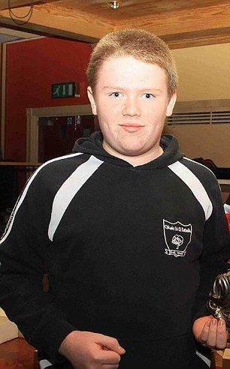
Sextortion ( web cam blackmail)- June 2015
The family of a County Tyrone teenager who took his own life after a gang blackmailed him over intimate photographs ...
Gerard and Teresa Hughes said a Nigerian gang demanded more than £3,000 from their son.
They then sent images of him to his friends on social media....Afterwards Ms O'Neill said there were lessons to be learned from how the case had been handled.
"Coming from such a tragic event there now appears be a step change in how such cases will be dealt with," she said.
“For instance Facebook previously waited three to four days following a complaint from a police service to remove a page.” The Hughes family were given reassurances that any such pages will now be removed immediately following such a complaint.
"Further to this the family were informed that the PSNI have now issued guidance to all its officers as to how to deal with such cases and will be increasing training in this field”.
"It is clear that this is a growing area for crime and needs to be focused on."
Ronan Hughes
Iulian Enache, 31, shared intimate photos belonging to Ronan after the schoolboy failed to pay a ransom. He was was jailed for 4 years.

Slide 22

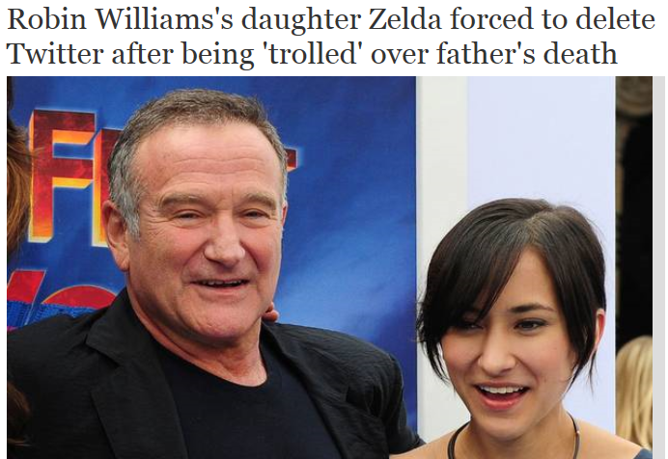
Trolling ( use a relevant news story involving a celebrity)
Trolling is when an individual (or group) posts offensive and hurtful messages online, such as on social network sites, chat rooms, online forums or blogs etc, with the intent of upsetting others.
Robin Williams's daughter, Zelda, has excused herself from social media after receiving cruel and offensive messages following his death..........Ms Williams said she intended to delete the Twitter app from her devices “for a good long time, maybe forever,” after several users sent her graphic, ‘Photoshopped’ images of her father.
The 25-year-old, who is herself an actor, also left her Instagram account dormant. “I will be leaving this account ... while I heal and decide if I'll be deleting it or not,” she wrote in a caption. “In this difficult time, please try to be respectful of the accounts of myself, my family and my friends.”

Slide 23
Emotional Health and well-being
The effects of social media on mental wellbeing-rf Internet matters.org
An overview of the research generally points to 3 main factors when it comes to why the overuse of social media can negatively impact on the mental health of young people:
1. Impact on Sleep
Heavy usage can have a negative impact on physical well being which in turn can affect mental health. This is particularly relevant when it comes to sleep disturbance. Several studies have linked sleep difficulties to screen time.
2. Use as life comparing tool
While social media was initially set up as a means of connecting with others, it is now also used as a means of comparing. It has become a barometer of how we measure up to others and this is a particular issue for young people who are socialized through the school system to ‘grade’ themselves in relation to their peers.
The nature of social media is such that most people present the highlights of their lives more regularly than the boring stuff, so these highlights appear to be the norm.
Notes:
Number of ‘likes’ and ‘friends’ is a status symbol.

Slide 24
Emotional Health and well-being
3. Chasing likes on posts to drive self-worth / self-esteem
Being too active on Social media and worrying about regularly posting pictures and status updates has been linked to anxiety, poor body image and diminished mental health. ….This preoccupation with how other people react to what we post on social media can lead young people to feel unsure about their value. They may start to worry about how they are seen, making them more self-critical of both their physical appearance and their lives in general.
Constant posting may also open them up to receiving more negative or mean comments on line, rather than compliments or praise. Potentially they may be more at risk of being cyberbullied, which has been linked to serious depression and even suicidal behaviour in extreme cases.

Slide 25
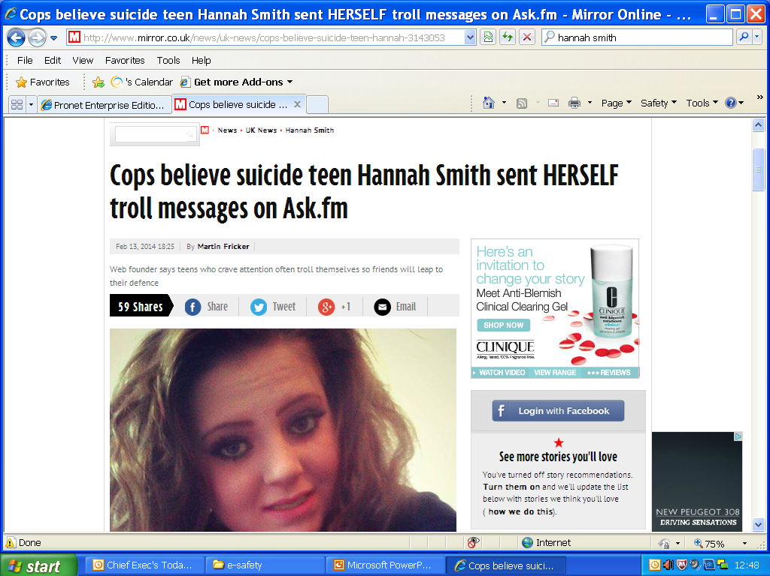
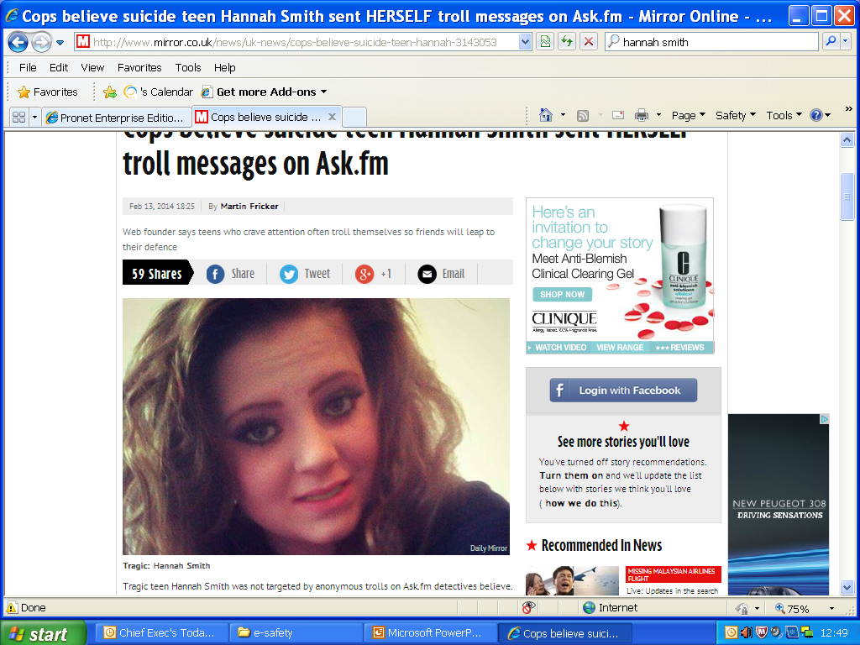
Self-trolling (use a relevant news story)
Tragic teen Hannah Smith was not targeted by anonymous trolls on Ask.fm detectives believe.
Instead detectives believe the troubled 14-year-old sent herself abusive messages on the popular social networking website.
Popular schoolgirl Hannah was found hanged in her bedroom inside her family home in Lutterworth, Leics. last August 2013.
Dozens of abusive anonymous messages were found on Hannah’s Ask.fm profile following her death - raising fears she had been targeted by trolls.
But during a pre-inquest review into her death it emerged there was no evidence she was the victim of trolling .
Dad Dave, 45, revealed after the hearing at Leicester Town Hall that police told him Hannah sent the anonymous messages to herself.
Ask.fm said that 98% of the messages had come from the same IP address as Hannah’s.
A source said: “The company have looked at every identity - the IP addresses are trackable. She posted the anonymous things herself”- rf Daily Mail.
Notes:
N.B This new story is the latest ‘public domain case’- as of January 2018.

Slide 26
Grooming
Grooming used to be a complex activity requiring manipulation of the child and their environment – this has been simplified by technology (available 24/7), ease of access to children through IT communications, naivety of parents, carers and protectors and the availability of a number of social networking sites
Grooming process may take minutes, hours, days or months
Groomers remain at different phases depending on the dynamics between their goals, needs or style and the reactions of the young person
Offenders tend to use what worked previously
Use a wide range of internet facilities to contact young people
Use multiple identities
Use blackmail (sextortion )
No ‘one size fits all’ – range and fluidity of behaviours

Slide 27
What can we do?
Parents/carers can't possibly be on top of all of the systems their children use
Any internet enabled device can give access to web based systems.
Parents/carers don’t always understand why their children ‘share’ over social networking sites.
BUT:
Keep the lines of communication with your children as open as possible and work together to figure out what's appropriate for them, in terms of safety,
privacy, reputation and time management
Keep up to date with changing privacy settings
Talk with your children about their favourite tools – with genuine interest, not fear, because they're more likely to come to you if they ever need help
Share concerns with other family members and school/college

Slide 28
Useful Links and resources for parents and carers
https://www.dudleysafeandsound.org/onlinesafety
https://www.thinkuknow.co.uk/parents/
https://www.thinkuknow.co.uk/parents/Listing/?cat=75&ref=4824#mMain
( online safety films to watch with your children)
http://parentinfo.org/
https://www.internetmatters.org/
https://www.saferinternet.org.uk/advice-centre/parents-and-carers/resources-parents-and-carers
https://www.getsafeonline.org/
https://parentzone.org.uk/
https://parentzone.org.uk/system/files/attachments/Digital%20Parenting%206%20NEW.pdf
http://www.net-aware.org.uk/networks/?order=-popularity#
Fact Sheet- A comprehensive list of Information and Online resources
http://www.childnet.com/parents-and-carers
http://www.childnet.com/ufiles/online-safety-calendar-2017-2019.pdf
https://www.barclays.co.uk/digital-confidence/eagles/

Slide 29
Questions

